Slide 1
Programming
Recursive functions
5th lecture

Slide 2
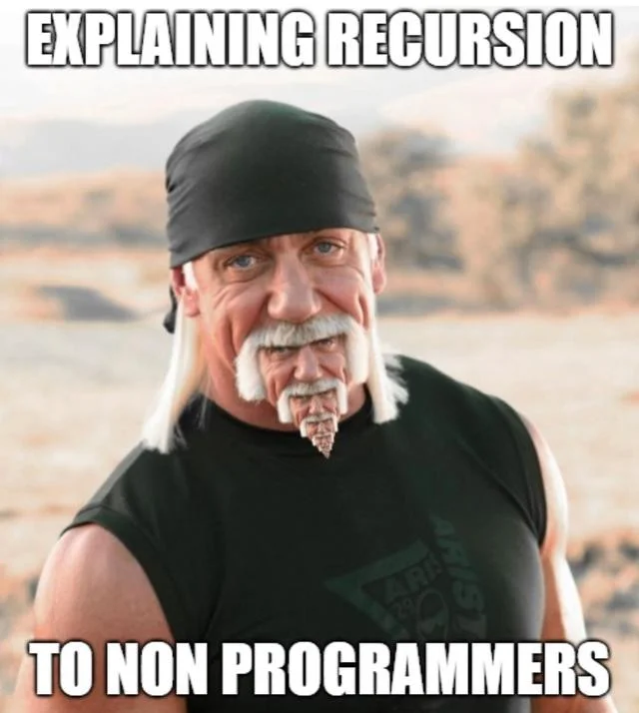
5th lecture
slide <number>

Slide 3
Algorithm
What is an algorithm?
  It is a function that converts input to output
  The algorithm calculates a result for each data, it always stops
5th lecture
Programing I
© Branko Kavšek, Jernej Vičič
slide <number>

Slide 4
Example
public int sestejDo0(int par) {
int vsota;
vsota = 0;
while (par != 0) {
vsota += par;
par--;
}
return vsota;
} /* sestejDo0 */
Is this an algorithm?
5th lecture
Programing I
© Branko Kavšek, Jernej Vičič
slide <number>

Slide 5
Sum numbers to 0
Int sestejDo0(int par) {
int vsota;
vsota = 0; /* initialization to 0 */
while (par != 0) { /* while par is bigger than 0 */
vsota += par; /* add par to sum */
par--; /* decrease par */
}
return vsota;
} /* sestejDo0 */
5th lecture
Programing I
© Branko Kavšek, Jernej Vičič
slide <number>

Slide 6
And now for something completely different
int sestejDo0(int par) {
int vsota;
vsota = 0;
if (par <= 0)
return 0;
else {
while (par != 0) {
vsota += par;
par--;
}
return vsota;
}
} /* sestejDo0 */
int sestejDo0(int par) {
if (par <= 0)
return 0;
else
return
sestejDo0(par-1)+par;
} /* sestejDo0 */
5th lecture
Programing I
© Branko Kavšek, Jernej Vičič
slide <number>

Slide 7
What the function really does
rezultat = (∑_{i=0..par} i) = (∑_{i=0..par-1} i) + par
int sestejDo0(int par) {
if par is smaller or equalt to 0, the result is 0;
else
the result is equal to the sum of numbers
from 0 to par-1,
and add par
} /* sestejDo0 */
int sestejDo0(int par) {
if (par <= 0)
return 0;
else
return
sestejDo0(par-1)
+ par;
} /* sestejDo0 */
5th lecture
Programing I
© Branko Kavšek, Jernej Vičič
slide <number>

Slide 8
Recursive definition
int sestejDo0(int par) {
if (par <= 0)
return 0;
else
return
sestejDo0(par-1)+par;
} /* sestejDo0 */
int sestejDo0(int par) {
if (par <= 0)
result is 0;
else
result is sum of the smaller problem and par
} /* sestejDo0 */
Stoping condition
Step divide and conquer (divide et impera) (deli in vladaj)
5th lecture
Programing I
© Branko Kavšek, Jernej Vičič
slide <number>

Slide 9
Again - algorithm
int sestejDo0(int par) {
if (par <= 0)
return 0;
else
return
sestejDo0(par-1)+par;
} /* sestejDo0 */
Is this recursive function an algorithm?
Yes, it stops for every value of par.
Proof (induction on parameter par):
  Basis: for each par <= 0 from the source code
  Hipothesys: if the statement par = n-1 is true, than it is true also for par = n
  Step: say, the function stops for par-1; then it certainly stops for par (from the source code)
5th lecture
Programing I
© Branko Kavšek, Jernej Vičič
slide <number>

Slide 10
Recursion and iteration
Each iteration can be translated into recursion
  public static void print(int[] polje) {
  for(int i = 0; i < polje.length; i++)
  {
  System.out.print(polje[i]);
  System.out.print(“ “);
  }
  System.out.println();
  } // print
5th lecture
Programing I
© Branko Kavšek, Jernej Vičič
slide <number>

Slide 11
Print all elements of the array
public static void print(int[] polje) {
for(int i = 0; i < polje.length; i++)
System.out.print(polje[i] + “ “);
System.out.println();
} // print
public static void print(int[] polje, int i) {
if (i >= polje.length)
System.out.println();
else {
System.out.print(polje[i] + “ “);
print(polje, i+1);
}
} // print
5th lecture
Programing I
© Branko Kavšek, Jernej Vičič
slide <number>

Slide 12
Print all elements of the array
if we come to the end of the array, print last element, else
print the next character (the first in the current array) and the rest of the array
public static void print(int[] polje, int i)
{
if (i >= polje.length)
System.out.println();
else {
System.out.print(polje[i] + “ “);
print(polje, i+1);
}
} // print
5th lecture
Programing I
© Branko Kavšek, Jernej Vičič
slide <number>

Slide 13
Search for an element
public static boolean member(int[] polje, int elt) {
for(int i = 0; i < polje.length; i++)
if (polje[i] == elt) return true;
return false;
} // member
public static boolean
member(int[] polje, int elt, int i) {
if (polje[i] == elt) return true;
if (i >= polje.length) return false;
return member(polje, elt, i+1);
} // member
5th lecture
Programing I
© Branko Kavšek, Jernej Vičič
slide <number>

Slide 14
Search for an element
if we find the element, return true
if we come to the end of the array, return false
else search the rest of the array
public static boolean
member(int[] polje, int elt, int i) {
if (polje[i] == elt) return true;
if (i >= polje.length) return false;
return member(polje, elt, i+1);
} // member
5th lecture
Programing I
© Branko Kavšek, Jernej Vičič
slide <number>

Slide 15
Search for the biggest element
If we are at the end of the array, return the biggest element, else:
check whether the current element is bigger than previously found element and, if so, this element becomes the new current biggest element
then look in the rest of the field, if there a bigger element
5th lecture
Programing I
© Branko Kavšek, Jernej Vičič
slide <number>

Slide 16
Search for the biggest element
public static
int maximum(int[] polje, int i, int trenMaks) {
if (i >= polje.length) return trenMaks;
if (polje[i] > trenMaks) trenMaks = polje[i];
return maximum(polje, i+1, trenMaks);
} // maximum
Call like this:
what about maximum(polje, 0, polje[0])
this call? maximum(polje, 1, polje[0])?
5th lecture
Programing I
© Branko Kavšek, Jernej Vičič
slide <number>

Slide 17
Search for the biggest element - 2.
If this is the last item in the array, then this is the biggest element in the array, otherwise:
find the biggest element in the remainder of the array
check whether the current element is bigger than the current biggest element in the remainder of the field and, if so, we claim this is the current biggest element
5th lecture
Programing I
© Branko Kavšek, Jernej Vičič
slide <number>

Slide 18
Search for the biggest element - 2.
public static int maximum(int[] polje, int i) {
int maksPreost;
if ((i+1) == polje.length) return polje[i];
maksPreost = maximum(polje, i+1);
if (polje[i] > maksPreost) maksPreost = polje[i];
return maksPreost;
} // maximum
Call like this:
maximum(polje, 0)
5th lecture
Programing I
© Branko Kavšek, Jernej Vičič
slide <number>

